Slide 1
FWD Project
TOGAF 9 - Core Diagrams
Environments and Location Diagram
Phase D – Technology Architecture

Slide 2
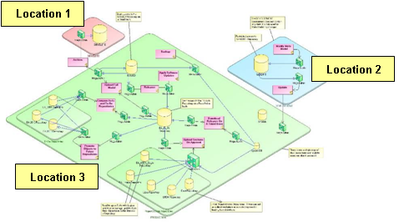
Environments and Location Diagram

Slide 3
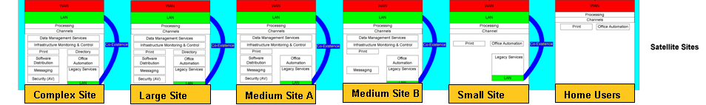
Environments and Location Diagram

Slide 4
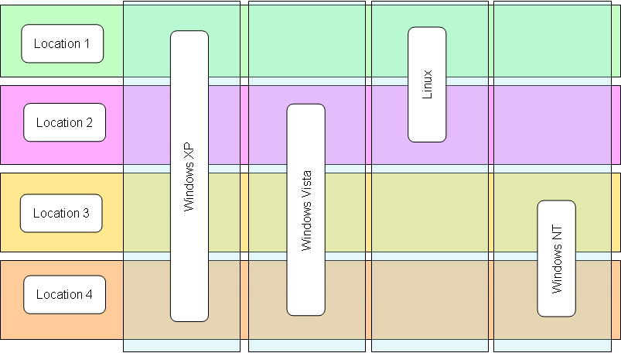
Environments and Location Diagram

